Slide 1
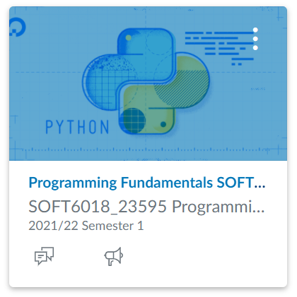
SOFT6018: Programming Fundamentals
Week 2 - Lecture 4

Slide 2

Concept review
Escape sequences
\n newline
\t tab
\’ single quote
\” double quote
\\ backslash
Numeric operators
+ addition
* multiplication
- subtraction
/ division
// integer division
% modulus (remainder)
** exponent
Keyboard input
Use input() to get keyboard input, always processed as a string

Slide 3
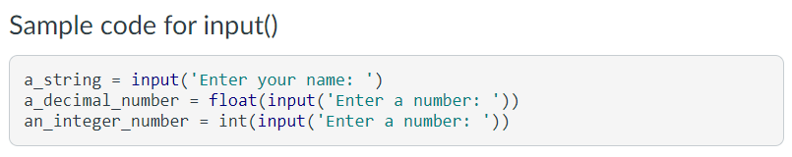
Keyboard input in Python
Check documentation for a function in PyCharm using ctrl+q
input() always treats what the user typed as a string
Functions to convert strings to numbers

Slide 4

Code it yourself….
Ask the user for the cost of a cup of coffee and for the number of coffees purchased.
Print out the total cost of the coffees purchased.

Slide 5
Named constants
A named constant is a value which should not change during execution of a program.
Named constants are written in all uppercase using snake notation
They should be declared at the beginning of your python script
PI = 3.14
MINUTES_PER_HOUR = 60

Slide 6
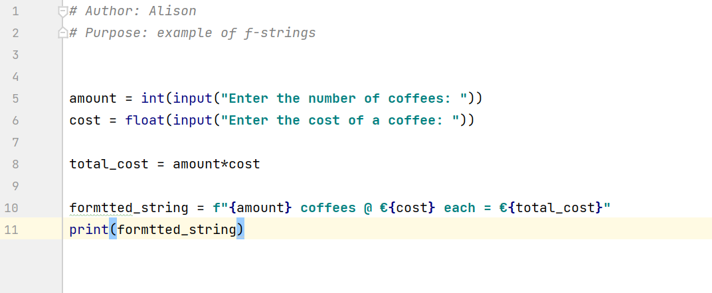
f-strings
f-strings start with f"" and use {} as placeholders
These are usually combined on one line

Slide 7
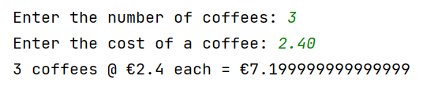
Result of an f-string

Slide 8
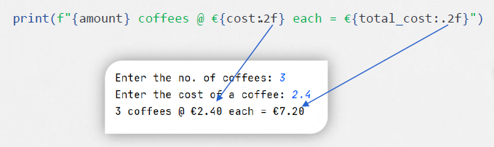
Formatting placeholders
{ placeholder : format specifier }
the colon (:) starts the formatting specification
the precision designator (.2) shows how many decimal places
the type designator (f) shows the type of number

Slide 9
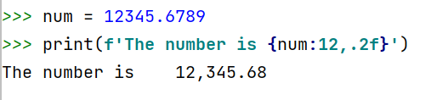
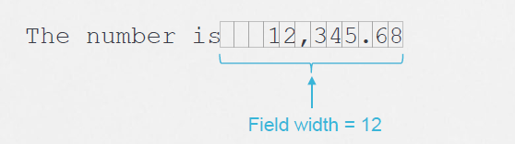
Specifying a minimum field width
Try this ->

Slide 10
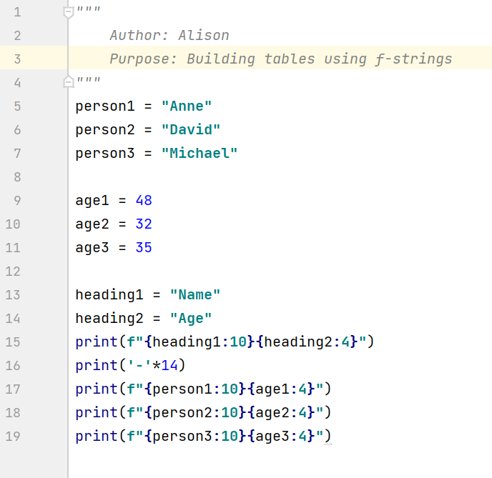
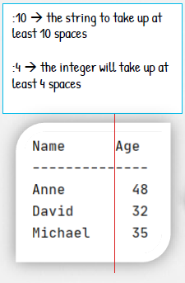
f-strings generating tables
Try this ->

Slide 11
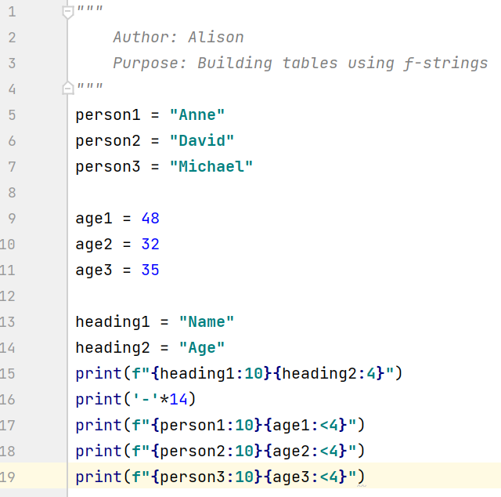
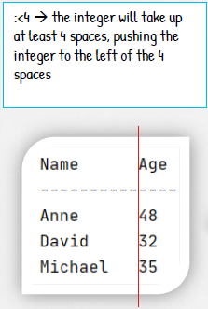
f-strings generating tables (alignment)

Slide 12
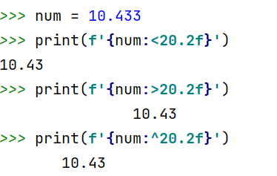
Aligning values within a field
Use < for left alignment
Use > for right alignment
Use ^ for centre alignment
Examples

Slide 13
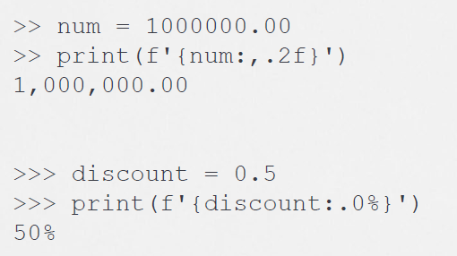
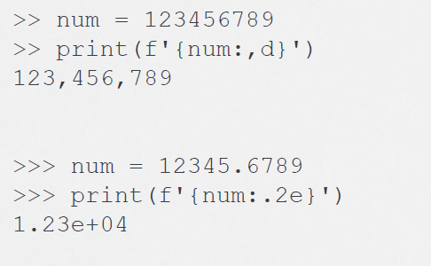
f-string examples (homework)

Slide 14
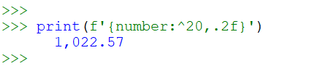
f-string designator order
The order of designators in a format specifier
[alignment][width][,][.precision][type]
Example

